Slide 1
Employee Data Analysis using Excel
STUDENT NAME: PATHARA BABY
REGISTER NO: 312201009, asunm10942568,(BB9C553FA62918DB9F54E47E66973173).
DEPARTMENT: B.COM(GENERAL) 3rd year .
COLLEGE: D.R.B.C.C.C.HINDU COLLEGE.

Slide 2

PROJECT TITLE : -
Employee Performance Analysis using Excel

Slide 3


AGENDA :-
Problem Statement
Project Overview
End Users
Our Solution and Proposition
Dataset Description
Modelling Approach
Results and Discussion
Conclusion
3/21/2024 Annual Review

Slide 4

PROBLEM STATEMENT :-
Employee performance evaluations can help you easily know about the good work and efforts of the top performance . You will be able to provide positive reinforcements for carrying out tasks properly . Positive reinforcements are crucial for boosting workplace morale and the good performance of the employees .

Slide 5

PROJECT OVERVIEW
It is a rigorous and systematic approach to defining workforce problems and testing successful solutions. To achieve it’s highest potential.
Download the data from the edunet foundation .
Select the data from the excel to editing with format , filter.
Select the all data from the excel to new sheet to insert pivot table.
To put the columns to row, column, values like this ,and pivot table is ready for the charts .
To ready for the pivot charts in multiple times or multiple charts.
.

Slide 6

WHO ARE THE END USERS?
The project benefit for end users are employer, employees, organization, IT sectors.

Slide 7

OUR SOLUTION AND ITS VALUE PROPOSITION
Conditional formatting : To use blank values.
Filtering : To use missing items.
Inserts : To choose the pivot table.
Pivot table : To find the grand total of employee data analysis.
Charts : For see the employee database in percentage.

Slide 8
Dataset Description :-
Employee data set – edunet foundation [ 9 features ]
Feature : 6 features
Employee I’d – like [ PR00147 ]
Gender – [Male and female]
Name - [Minerva Ricardot ]
Salary – [105468.7 ]
FTE - 1
Employee type – [Permanent ]

Slide 9
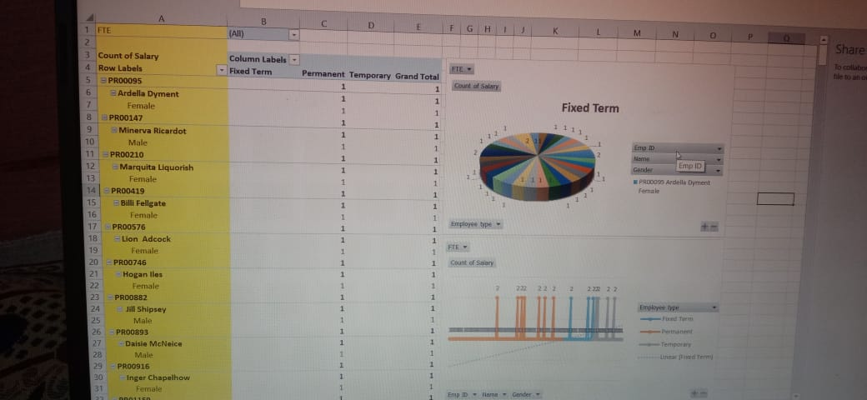

THE "WOW" IN OUR SOLUTION :-
3/21/2024 Annual Review
9

Slide 10
MODELLING :-
DATA COLLECTION : Download the edunet foundation .
DATA CLEANING : To clean the data from downloading data to editing.
TECHNIQUES : I choose the technique in first is format, filter, highlights the heading with colour .
RESULTS : Result is the data analysis shown on new sheets.
PIVOT TABLE : Select the data and distribute the pivot table in rows, column , values and extra ,.
CHART GRAPHS : Once distribute the pivot table and it should be shown on grand total with the data analysis then the pivot charts choose for the bar diagram, pie charts , extra,.
10

Slide 11
RESULTS :-
11

Slide 13
Conclusion :-
The employee data analyzing using with pivot table was clearly said to be how to analysis for the employee data in simple . How to calculate the different charts for the dataset description.

Slide 14


